Slide 1



Project on Network Modelling
29-08-2025
Sineshaw Legese Bayu
Rahma Jumaa Sheshe
Frank Chacky
Charles Arnest Obat
Sahar Trabelsi

Slide 2
Scenario

Slide 3
Scenario
Network Modeling with SIS for Malaria Training Participants Project Description. This project introduces students to the intersection of network analysis and epidemic modeling through a hands-on exploration of disease transmission dynamics. Using a dataset of participants from various countries. Herein, participants learn to construct social networks based on connection patterns and simulate disease spread using a Susceptible-Infected-Susceptible (SIS) model. The project demonstrates how network structure influences epidemic outcomes by modeling connections between individuals from the same countries, with Kenya serving as a hub connecting participants from different nations. Participants explore key epidemiological concepts, including transmission rates (β=0.4), recovery rates (γ=0.1), and intervention strategies, such as mask-wearing and identification of superspreaders. Through practical R programming, students gain experience with network visualization, epidemic simulation, and quantitative analysis of public health interventions. The project emphasizes real-world applications by examining scenarios such as the impact of protective measures introduced mid-outbreak and the role of highly connected individuals in accelerating disease spread. This project aims to bridge theoretical epidemiology with computational methods, preparing students to understand and model infectious disease dynamics in networked populations—a critical skill for modern public health analysis.

Slide 4
Network Modeling with SIS
Hands-on project combining network analysis & epidemic modelling
Builds social networks from participants across countries (Kenya as hub)
Uses SIS model to simulate disease spread
Key parameters: β = 0.4 (transmission), γ = 0.1 (recovery)
Explores interventions: mask-wearing, superspreaders, mid-outbreak measures.
Practical skills: R programming, visualization, simulation, public health analysis
Goal: Bridge theory & computation to understand infectious disease dynamics

Slide 5
recovery
susceptible humans
infectious
humans
SIS
transmission
Notes:
We build a malaria transmission model: combine SIS for humans

Slide 6
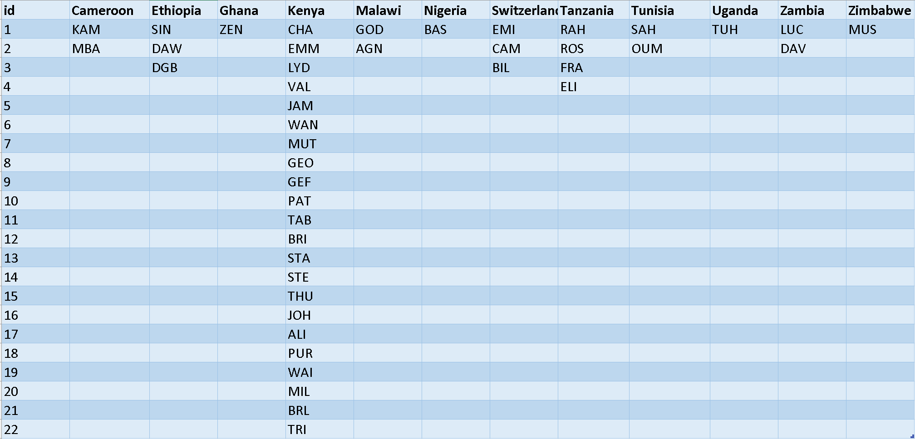
Participants across the Countries
Notes:
We build a malaria transmission model: combine SIS for humans

Slide 7
Network structure critically influences disease transmission
Early intervention is more effective than delayed action
Targeted interventions can be more efficient than broad measures
Public health decisions require balancing effectiveness, cost, and feasibility
Mathematical modelling helps evaluate intervention strategies before implementation

Slide 8

Acknowledgements
Christian Selinger
Emilie Pothin
Cameline Orlendo
Zenabu Suboi
Geoffrey Githinji
billy.bauzile@swisstph.ch

